Slide 1

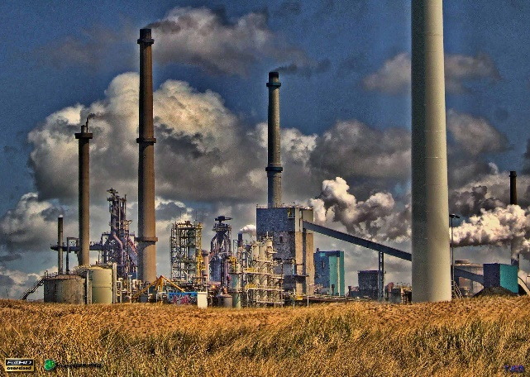
On Becoming a Leader In Risk Management
Fundamentals of RM
RM System and Process
Leadership in RM
Incident Investigation
RM Tools & Challenges
RM in Industry
People & Org.
Applications & Perspectives
ENGG404 – SEMINAR
Case #6: The Legal Side Of Risk Management and the Hub Oil Incident
1
Notes:
ENGG404 Lecture 00 - Day 1
2012 Fall
1
1

Slide 2
Business Meeting Rules apply!
Give your undivided attention …
Put cell-phones on vibrate for that all-important interview or job offer.
Put away your newspapers!
Put away all of your other e-devices (laptops and tablets, MP3 players, etc.)
NO TEXTING, NO FACEBOOK, NO TWEETING!
Please sit together with your team.
You may also find it beneficial to sit near the front
DADD
Digital attention deficit disorder
Case #6: The Legal Side of Risk Management & Hub Oil
2
Notes:
2

Slide 3
Our Plan for Today:
Case #6: The Legal Side of Risk Management & Hub Oil
Purpose and Learning Outcomes of this Module
Print-outs:
Hub Oil Schematics
Chapter 4.2: The Cause & Effect Model for Incident Analysis
Questions, Mentimeter, and Courtroom Protocol
Introduce Our Guest Speaker.
Break at a little more than half-way.
Brief review of ABSA PPT
Review MM Questions: the floor is open for your questions.
Roster.
This PPT is posted on the Shared Resources folder.
Case #6: The Legal Side of Risk Management & Hub Oil
3
Notes:
3

Slide 4
Purpose of this Case Study:
To gain first-hand knowledge about the loss incident from the perspective of The Crown (our judicial system i.e. the people and government), including the events leading up to the incident, the incident, the impact on PEAP, and the aftermath of the incident.
To understand the legal side of risk management, specifically, what can happen when the process safety risks of operations and facilities are not managed.
To contrast the “corporate culture” in this small company at the expense of responsible operation through application of process safety risk management principles and practices.
To apply the Cause and Effect Model as a benchmark for your notes during the seminar, and to prepare you for your assignment and a portion of the team project that are relevant to this topic.
This seminar also serves two very practical purposes: It sets the stage for completing part of Assignment #2 and part of the Team Project Final Report!
Case #6: The Legal Side of Risk Management & Hub Oil
4
Notes:
4

Slide 5
Learning Outcomes of this Case Study:
Apply the cause and effect model to analyse the results of an incident investigation and root cause analysis, and critique those results.
Determine and categorize the immediate causes, basic causes, and latent causes of this loss incident.
Formulate the link between latent causes and recommendations for action, and generate recommendations for action that address those latent causes.
Create a persuasive argument with intent to convince leadership that recommendations are the right thing to do, and to persuade leadership to proceed with your set of recommendations.
This seminar is a lesson in advocacy!
Case #6: The Legal Side of Risk Management & Hub Oil
5
Notes:
5

Slide 6
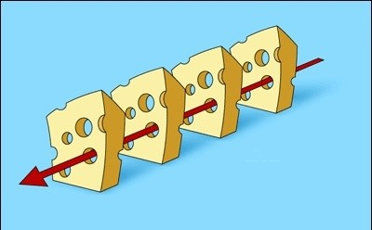

Model 4: The Swiss Cheese Model & Interrelation of Latent Causes & Human Errors
Recall this slide from Chapter 7.4 …
Why focus on behaviours AND on implementing a risk management program?
The worker knows critical parts of the system must always be working, and therefore is personally motivated to ensure those critical parts are always working …
… because the worker knows something bad will happen if these critical parts of the system fail. …
And what happens after that worker is no longer there?
The account of “George” in the Hub Oil Seminar.
This is why risk management programs are needed: When critical people are no longer part of the organization, the organization will fail if a program is not in place.
1
2
Planned activity and its hazards & risks
3
4
D
Successful outcome
Chapter 7.4: Applying the Principles of Human Motivation

Slide 7
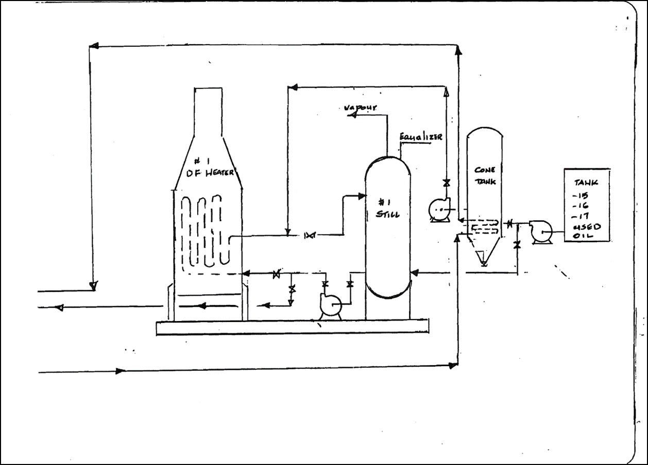
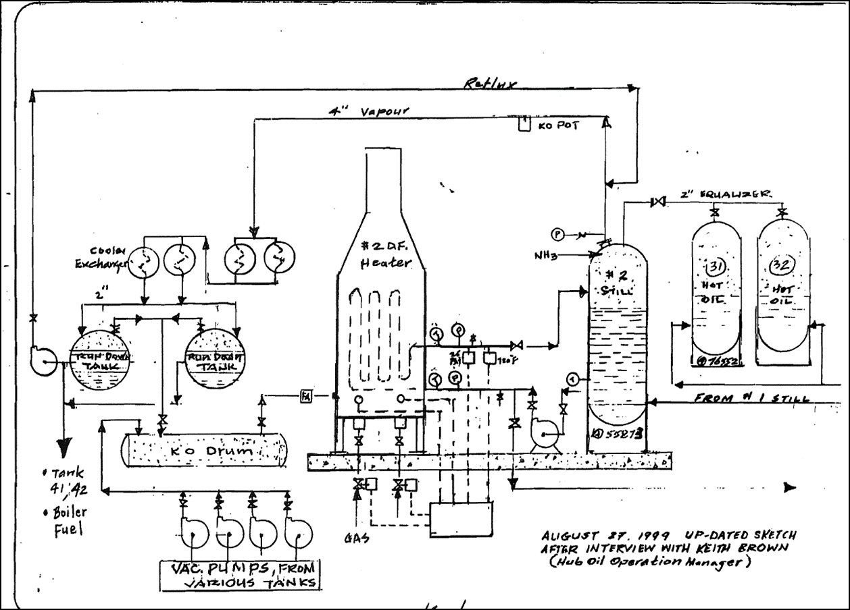
On-line Hand-outs:
Chapter 4.2: The Cause & Effect Model for Incident Analysis
Two Schematics
Case #6: The Legal Side of Risk Management & Hub Oil
7
Notes:
7

Slide 8
Chapter 4.2: Cause and Effect Model - Detailed
During the Seminar, identify on your form the various details of the incident, and begin to draw conclusions about the latent causes.
Case #6: The Legal Side of Risk Management & Hub Oil
8
Notes:
8

Slide 9
Chapter 4.2: Cause and Effect Model - Detailed
Link Basic Causes to Latent Causes.
Link Latent Causes to Recommendations.
During the Seminar, identify on your form the various details of the incident, and begin to draw conclusions about the latent causes.
Case #6: The Legal Side of Risk Management & Hub Oil
9
Notes:
9

Slide 10
Case #6: The Legal Side of Risk Management & Hub Oil
Note any questions that you may have and post on Mentimeter. Feel free to confer with your colleague to formulate and ask your question! MM should be open throughout the seminar.
Or, if the question is burning, raise your hand per court-room protocol.
Questions will be reviewed at the close of the presentation.
Case #6: The Legal Side of Risk Management & Hub Oil
10

Slide 11
Case #6: The Legal Side of Risk Management & Hub Oil
It is now my pleasure to introduce Susan McRory, Environmental Prosecutor, (Retired) Specialized Prosecutions Branch, Alberta Justice
And her presentation on the Hub Oil Loss Incident, August 9, 1999, Calgary.
Case #6: The Legal Side of Risk Management & Hub Oil
11
Notes:
11

Slide 12
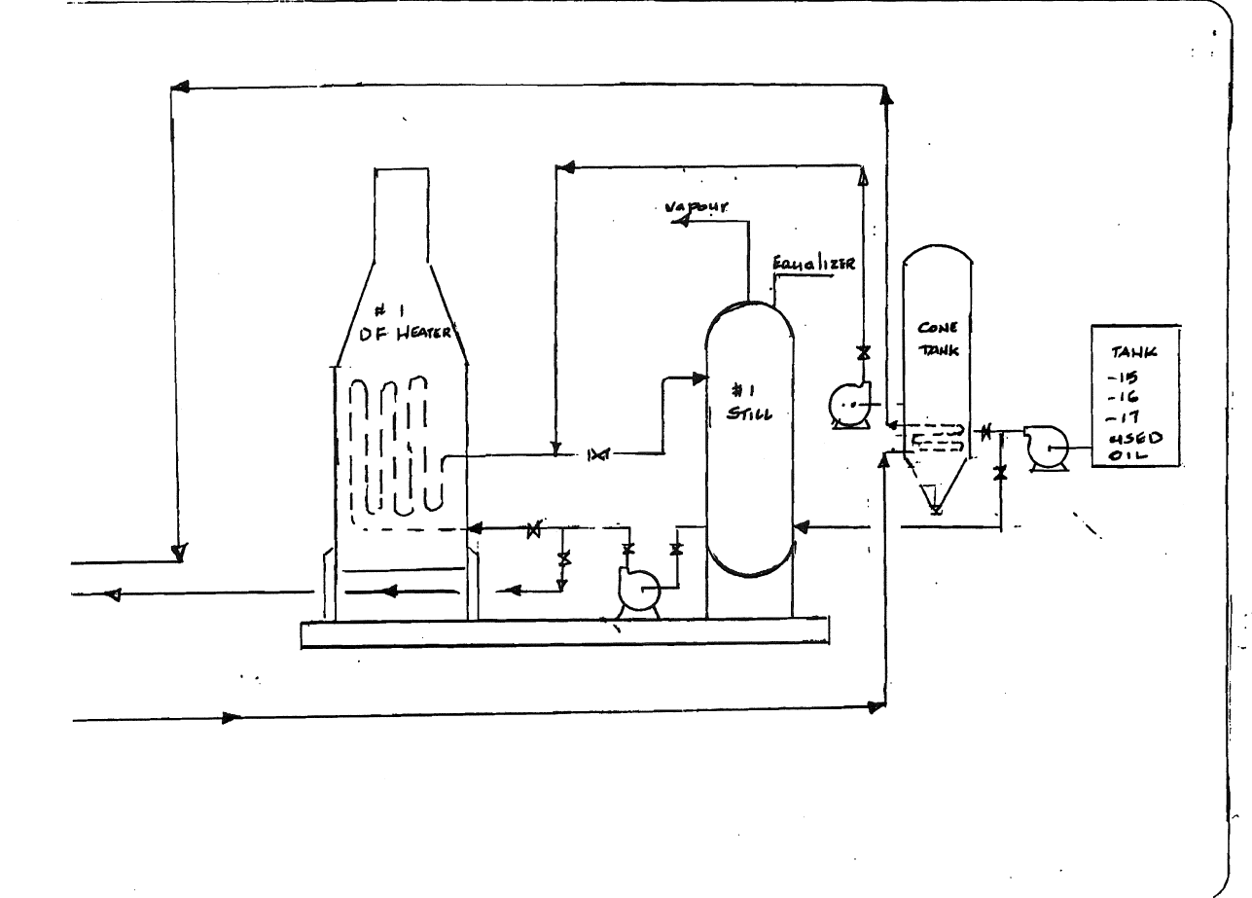
Schematic - Still #1
Still #1
To Still #2
Case #6: The Legal Side of Risk Management & Hub Oil
12

Slide 13

Schematic - Still #2
Still #2
From Still #1
Case #6: The Legal Side of Risk Management & Hub Oil
13

Slide 14
Students should have viewed this on eClass prior to the Seminar:
Case 06 Video1 ABJustice HubOil Loss Incident 1999.mp4 (from Alberta Justice, The Hub Oil Loss Incident, 9-August-1999)
00:00 – 01:00; Within minutes after the initial explosion; listen for the explosion at 0:25
03:05 – 03:40; Watch for the one manager at 3:09 (pause)
06:00 – 07:00; listen for the high-pitched whistling and watch for jet-fires; fire-fighters continuing to struggle with water blast; listen to the audio at 06:45 – 07:00
20:00 – 20:35; evacuation, smoke emissions, explosions
Other Videos in the News:
Case 06 Video2 Global News Video Calgary marks 20th anniversary of the Hub Oil explosion.mp4
Case 06 Video3 Global News Firefighter Garth Rabel reflects on Hub Oil explosion.mp4
Case 06 Video4 Global News Firefighter Mike Van Tetering reflects on Hub Oil explosion.mp4
Case #6: The Legal Side of Risk Management & Hub Oil
14
Notes:
14

Slide 15
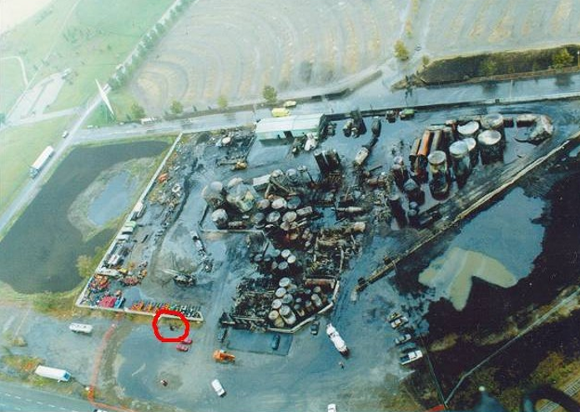
EXHIBIT PHOTOS
ABSA – MIKE POEHLMAN
Case #6: The Legal Side of Risk Management & Hub Oil
15

Slide 16
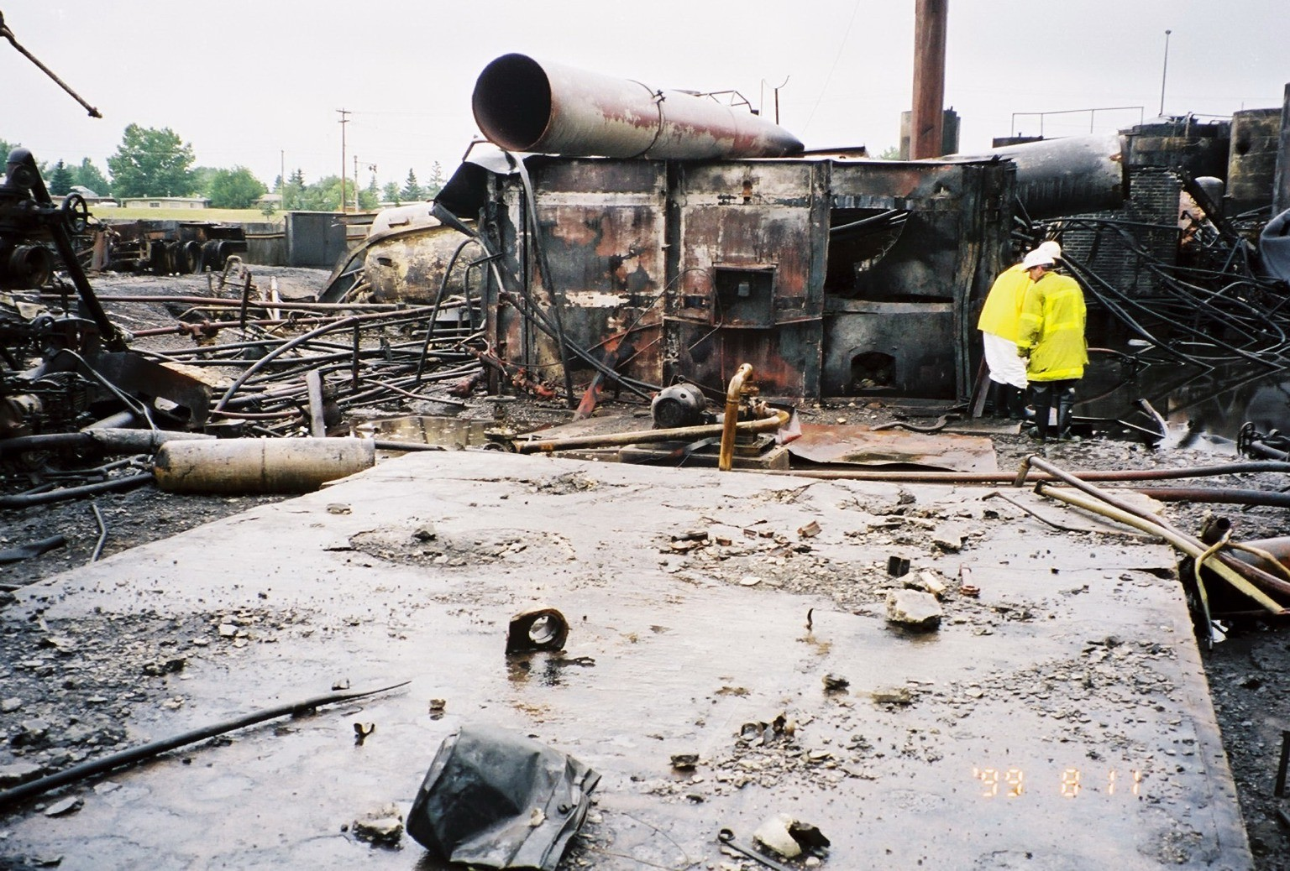
#2 Distillate all anchor bolts pulled from concrete pad
EXHIBIT PHOTOS
ABSA – MIKE POEHLMAN
Case #6: The Legal Side of Risk Management & Hub Oil
16

Slide 17
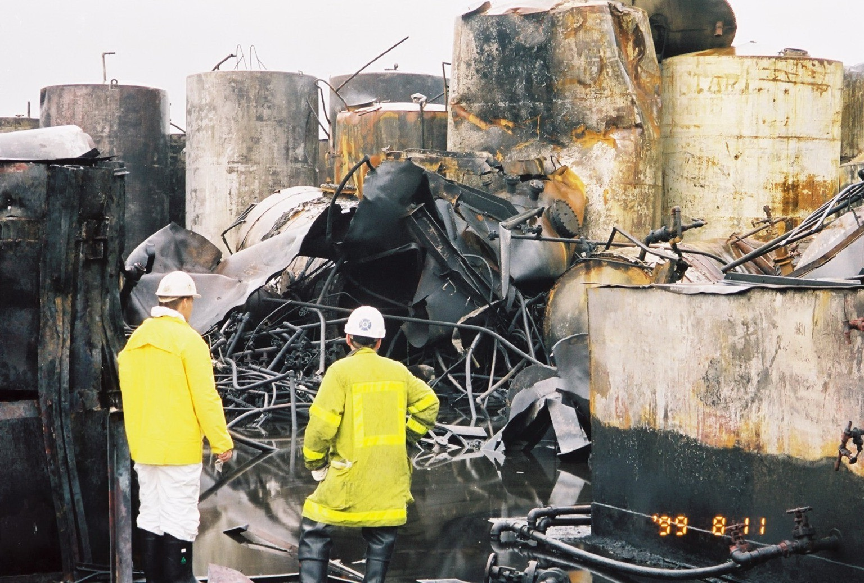
Remains of #2 distillate shell
EXHIBIT PHOTOS
ABSA – MIKE POEHLMAN
Case #6: The Legal Side of Risk Management & Hub Oil
17

Slide 18
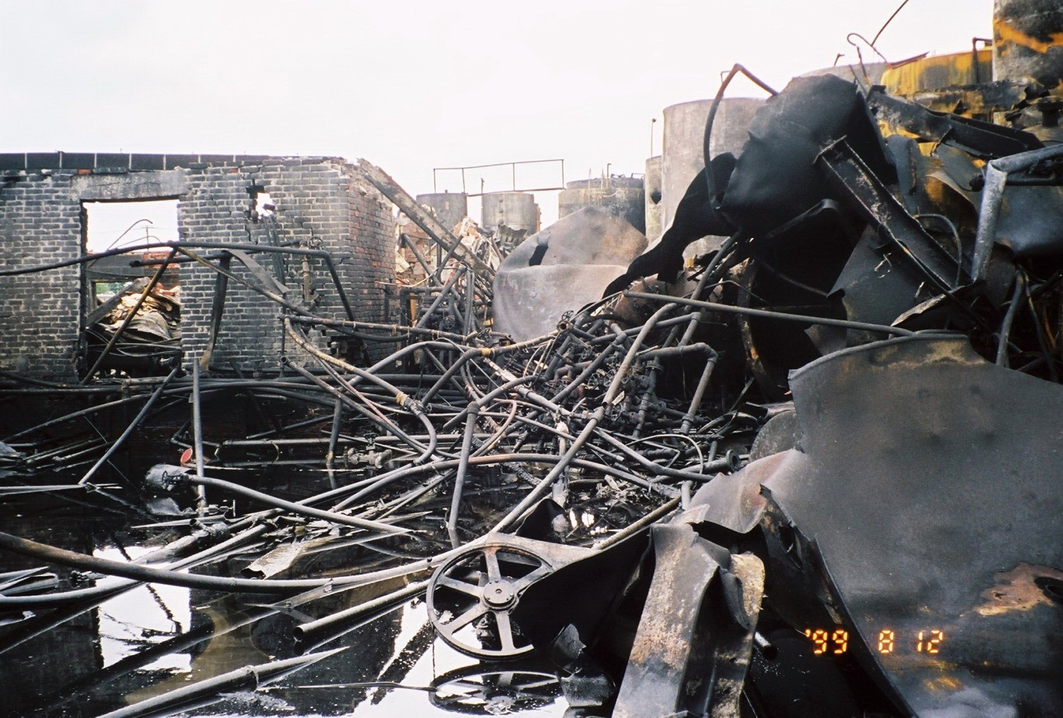
2.2 Boiler Room (Back)
EXHIBIT PHOTOS
ABSA – MIKE POEHLMAN
Case #6: The Legal Side of Risk Management & Hub Oil
18

Slide 19
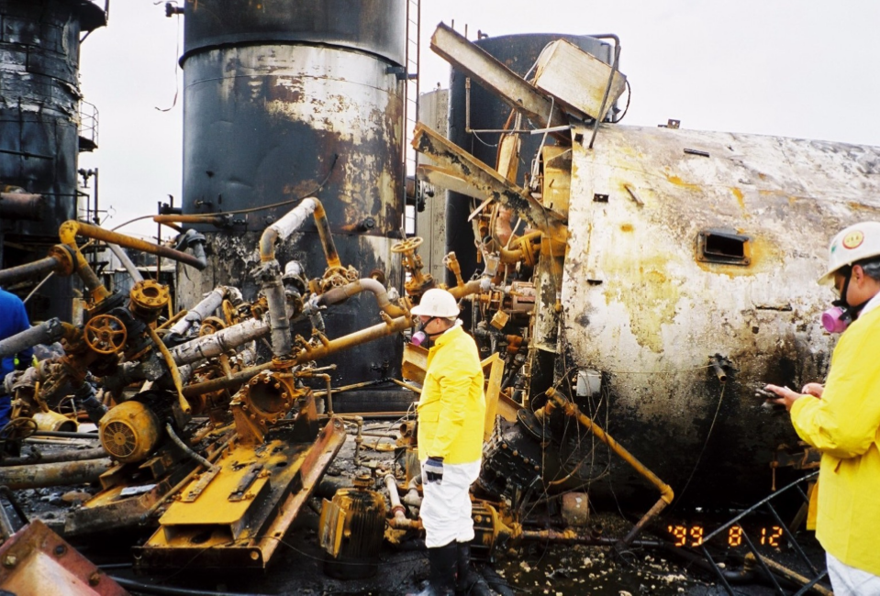
EXHIBIT PHOTOS
ABSA – MIKE POEHLMAN
Case #6: The Legal Side of Risk Management & Hub Oil
19

Slide 20
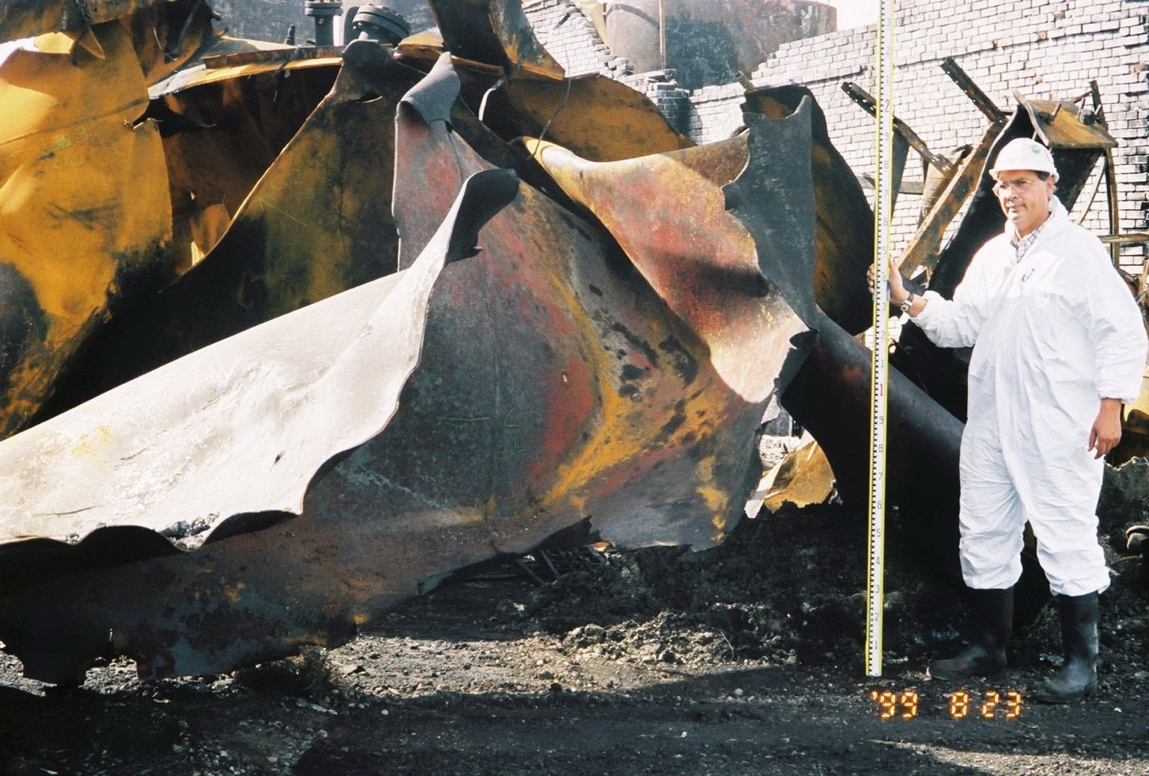
Shell (#2 Still)
EXHIBIT PHOTOS
ABSA – MIKE POEHLMAN
Case #6: The Legal Side of Risk Management & Hub Oil
20

Slide 21
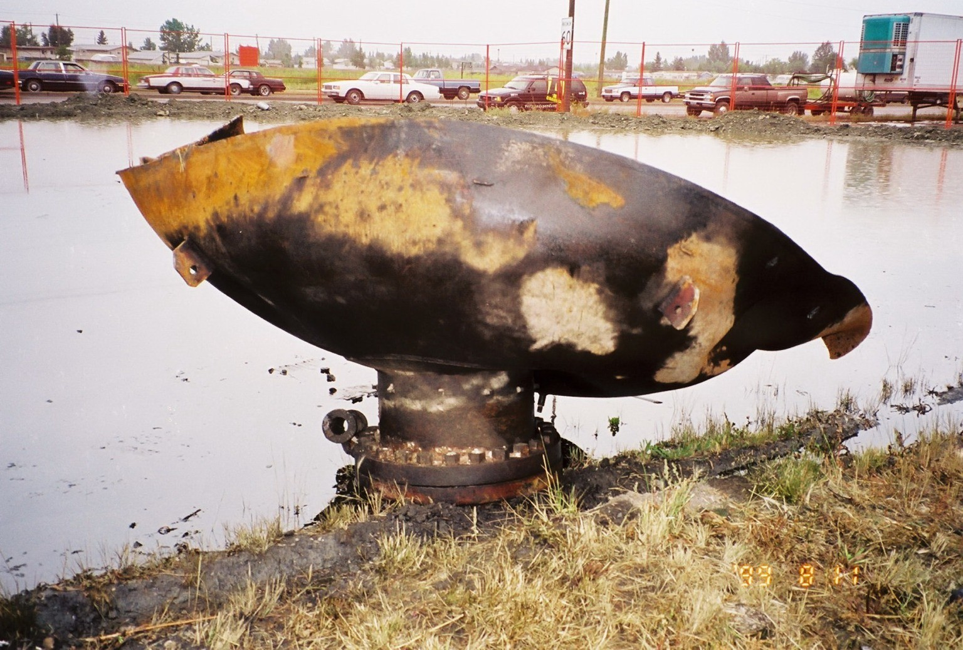
Repads and manways of pressure vessel
EXHIBIT PHOTOS
ABSA – MIKE POEHLMAN
Case #6: The Legal Side of Risk Management & Hub Oil
21

Slide 22
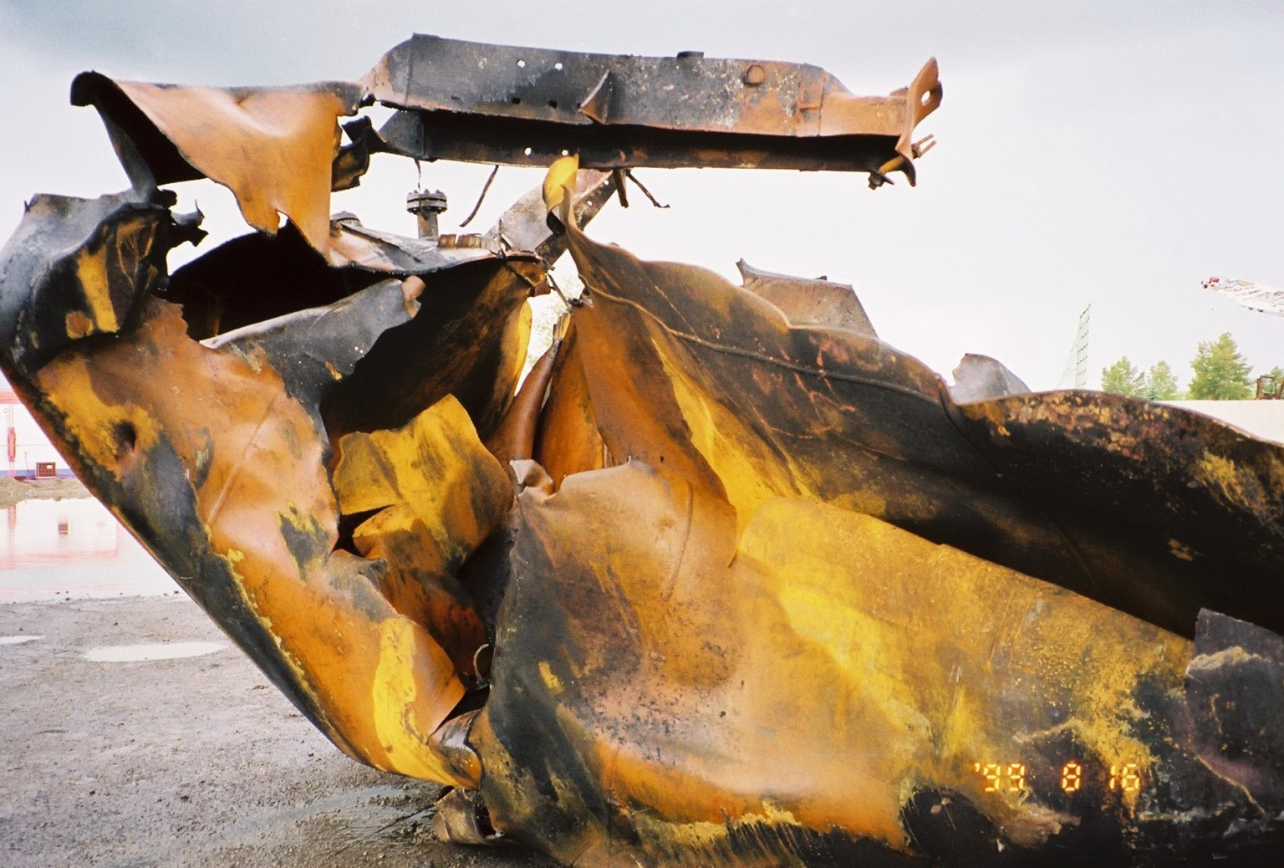
Shell section
EXHIBIT PHOTOS
ABSA – MIKE POEHLMAN
Case #6: The Legal Side of Risk Management & Hub Oil
22

Slide 23
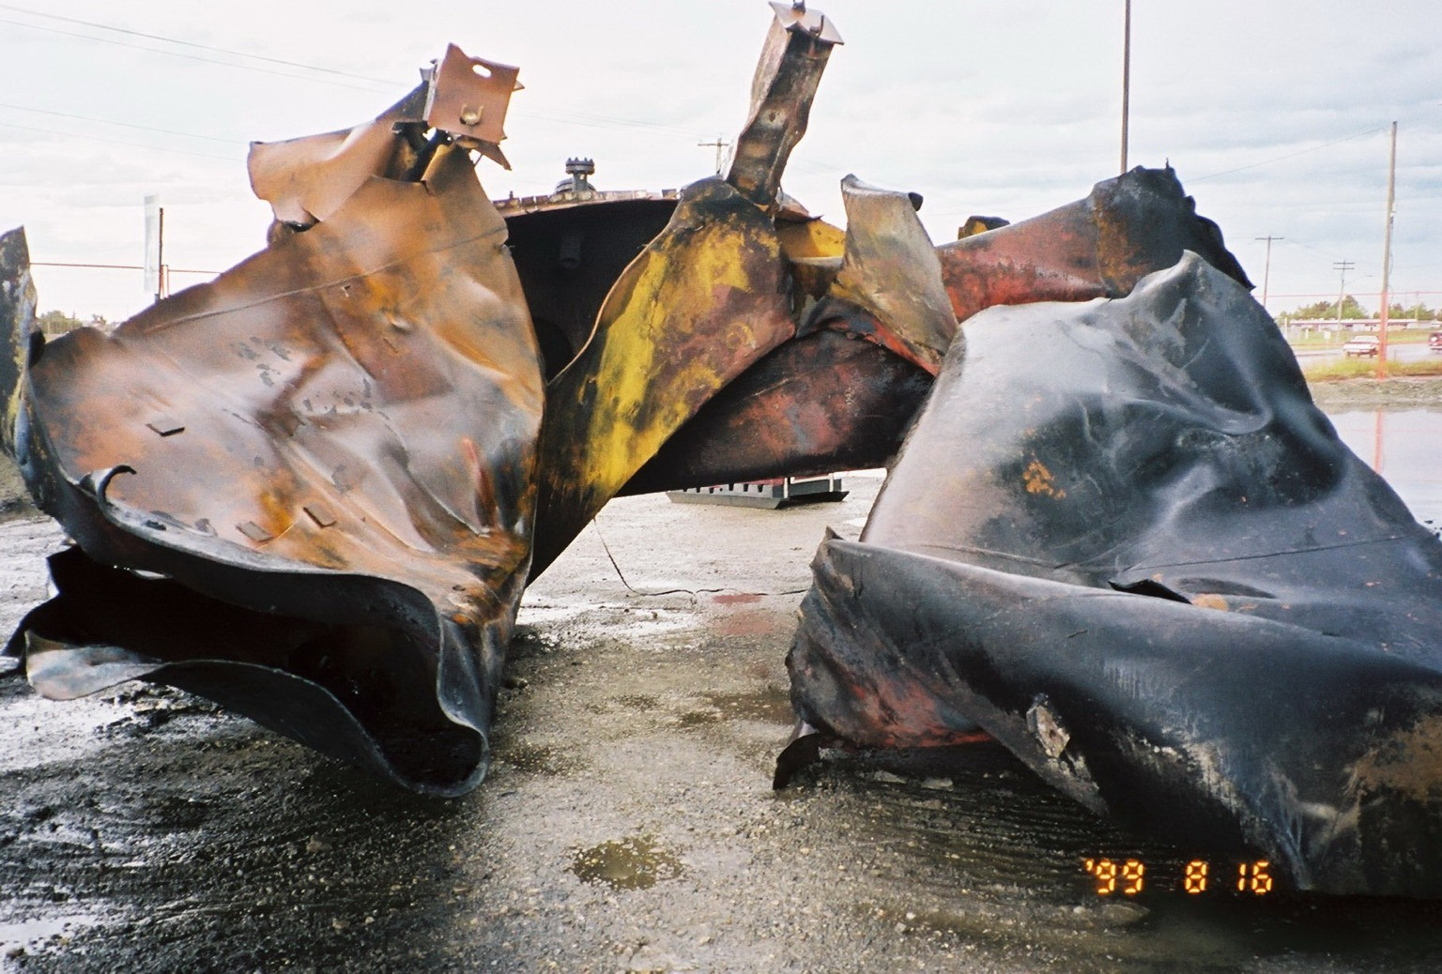
Shell opposite to nozzle
EXHIBIT PHOTOS
ABSA – MIKE POEHLMAN
Case #6: The Legal Side of Risk Management & Hub Oil
23

Slide 24
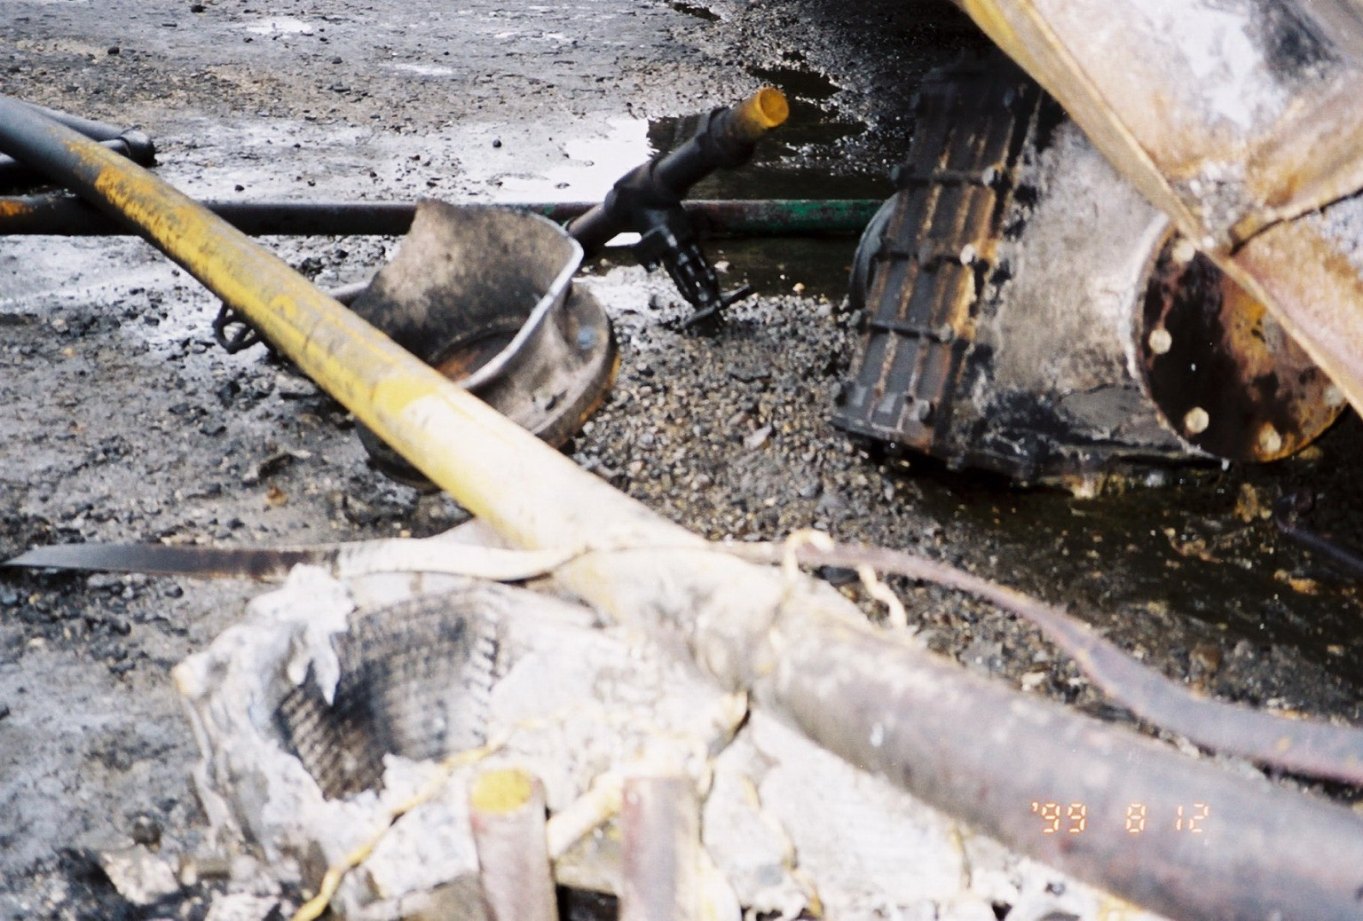
Destroyed flame arrestor
EXHIBIT PHOTOS
ABSA – MIKE POEHLMAN
Case #6: The Legal Side of Risk Management & Hub Oil
24

Slide 25
Case #6: The Legal Side of Risk Management & Hub Oil
Still #2
Still #2
15
“12”
0
30
From Still #1
Tubes, low point drains.
Case #6: The Legal Side of Risk Management & Hub Oil
25

Slide 26
Chapter 4.2: Cause and Effect Model - Detailed
During the Seminar, identify on your form the various details of the incident, and begin to draw conclusions about the latent causes.
Case #6: The Legal Side of Risk Management & Hub Oil
26
Notes:
26

Slide 27
Case #6: The Legal Side of Risk Management & Hub Oil
The floor is open for your questions.
Please take a few minutes to confer with your colleague to formulate and ask your question!
Raise your hand to ask, or post on MM.
Go BACK to the slide in www.mentimeter.com for the MM questions posed by students.
Case #6: The Legal Side of Risk Management & Hub Oil
27

Slide 28
Case #6: The Legal Side of Risk Management & Hub Oil
Two articulate questions were submitted previously:
I am interested in the legal responsibility. More specifically, the difference between company responsibility and the individual responsibility of the engineers when an incident like this takes place.
Can an engineer be held personally responsible if it was his/her fault the incident occurred?
Or will the company as a whole be responsible?
ROSTER!
Case #6: The Legal Side of Risk Management & Hub Oil
28

Slide 29

Case #6: The Legal Side of Risk Management & Hub Oil
Let’s express our appreciation for Susan McRory!
Thank you!
Case #6: The Legal Side of Risk Management & Hub Oil
29
Notes:
29

Slide 30
Instructions to Professors (No need to present this slide to students):
At the break, if she has not already spoken about these points, prompt her about these ones – some come up before the break, and some come up after:
The culture of the organization, as defined by the owner, a former elementary school teacher.
The history of George and his approach to risk management: his actions on the pressure relief valve, the use use of louvres / shutters on the furnace, his use of various preussre gauges along the piping system, and his use of the one large “0-30psig” pressure gauge at the top of the still and a redundant gauge; his educational background and his expectations of others who have more education (“If I can do it, you can do it.”); the culture he instilled at Hub Oil (“If it ain’t broke, don’t fix it.” “I developed and invented this technology, so don’t tell me how to do it.” “We can do it better. (do-it-yourself instead of hiring others)”. His assumption that, because he had no formal education, that an educated engineer / technologist / technician should be ale to grasp all of this plant and its processes quite easily.
The history of the young professional engineer who moved into sales and marketing (glamourous work) instead of working in the plant to improve operations.
The history of the grandson, the procedures that were prepared and locked away; the ideas about improving the heater efficiency with a maintenance shutdown to steam out / hydroblast the tubes to remove the coke; steam-blast done by a specialized contractor company the first time, and a year later, it was done “in house” and the drain plugs were not removed to drain the residual water after steam-out.
Skip this slide in the lecture.
Case #6: The Legal Side of Risk Management & Hub Oil
30
Notes:
30

